Slide 1

Entrance Exam FORM Portal
33120 Darshan
33135 Aditya
33171 Arman

Slide 2
Contents
Introduction
Problem Statement
Objectives
Scope
Technologies
Result
Outcome

Slide 3
Introduction
An entrance exam form portal is an online platform that allows students to register and apply for entrance exams to various universities, colleges, and institutions.
The portal provides a simple and efficient way for students to apply for admission to their desired institution.
This presentation will discuss the features and benefits of an entrance exam form portal.

Slide 4
Problem Statement
To design and develop an entrance exam form portal using react.js, node.js, mongoDB and express.js for simplifying the process of entrance exam.

Slide 5
Objectives
To provide a user-friendly and efficient platform for students to apply for entrance exams to various universities, colleges, and institutions.
To simplify the application process and reduce the time and effort required for students to apply for entrance exams.
To ensure error-free data entry by providing an online application form that automatically validates the data entered.
To offer various online payment options to provide a convenient and hassle-free method for students to pay application fees.

Slide 6
Scope
Development of an online platform that provides a user-friendly interface for students to register and apply for entrance exams to various universities, colleges, and institutions.
Integration of online payment gateways to facilitate the payment of application fees through various payment methods such as credit/debit card, net banking, and mobile wallets.
Implementation of an online application form that allows students to fill in their academic qualifications, personal details, and other relevant information required for the entrance exam.
Development of an automated system that validates the data entered by the students and generates an admit card for the eligible candidates.

Slide 7




Technologies

Slide 8
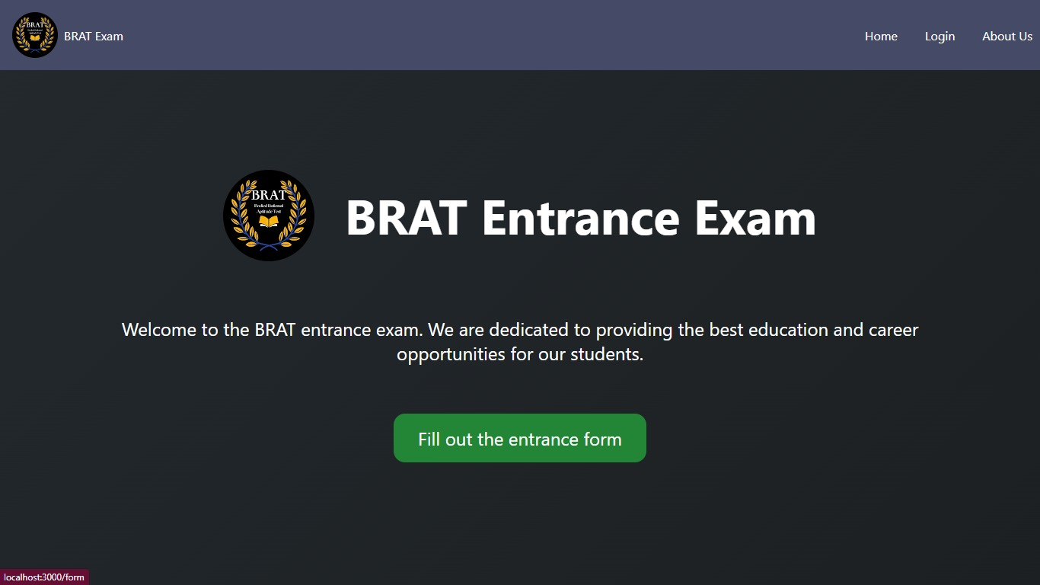
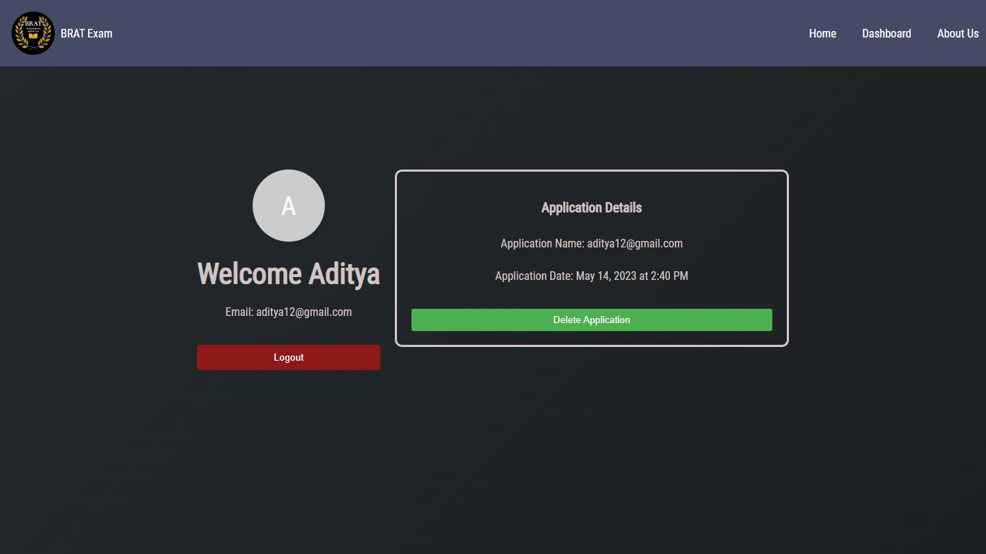
Result

Slide 9
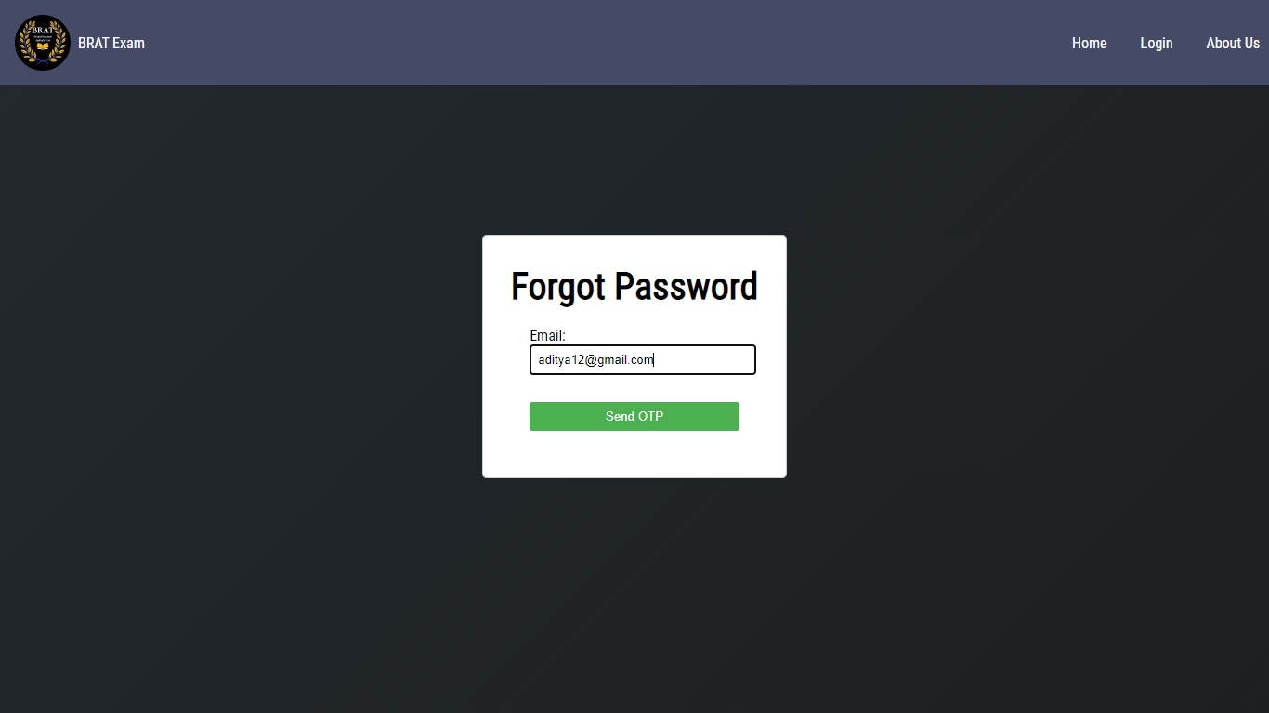
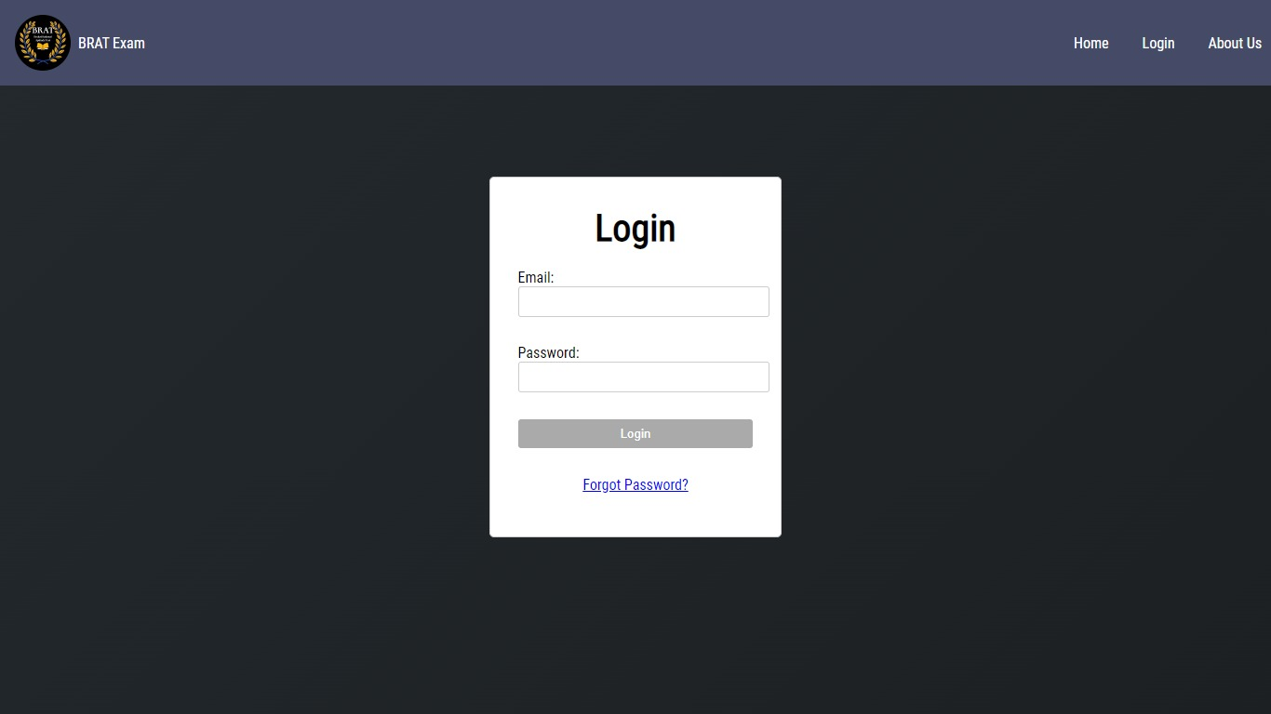
Result

Slide 10
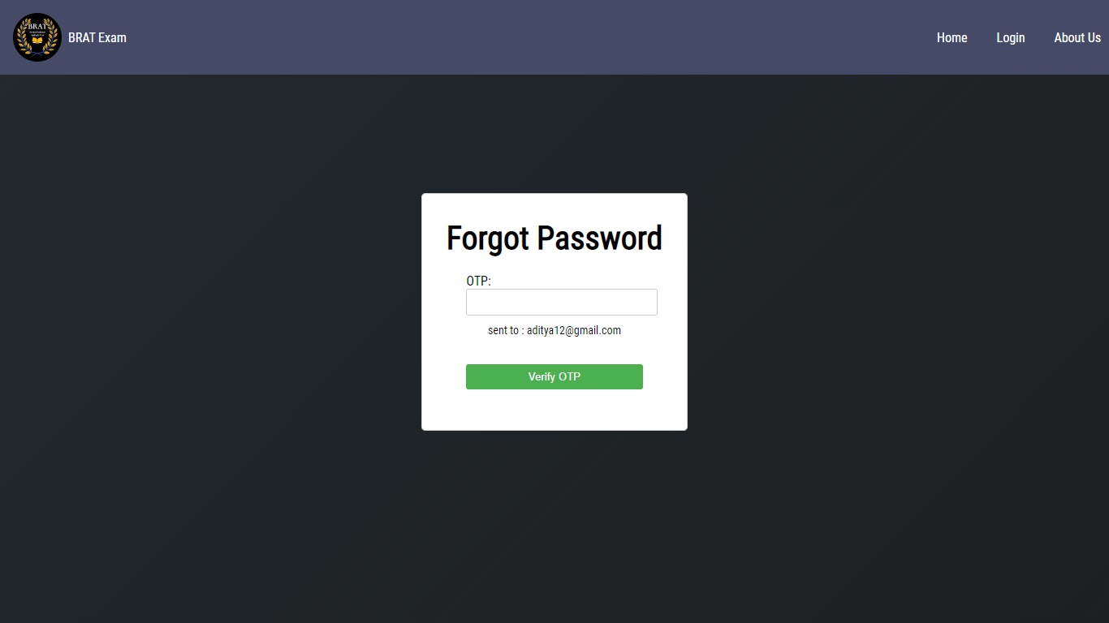
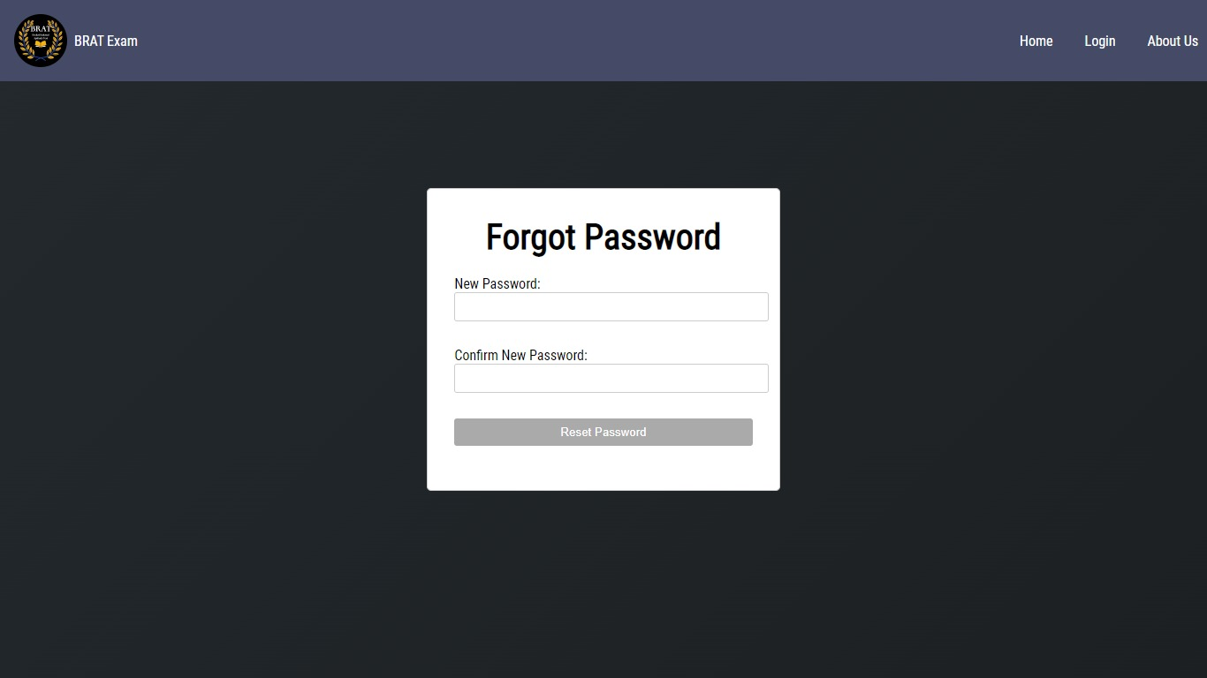
Result

Slide 11
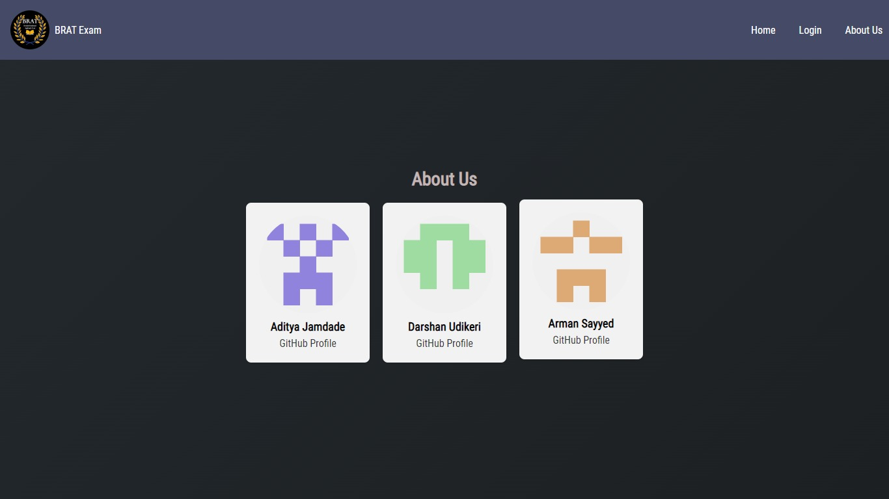
Result

Slide 12
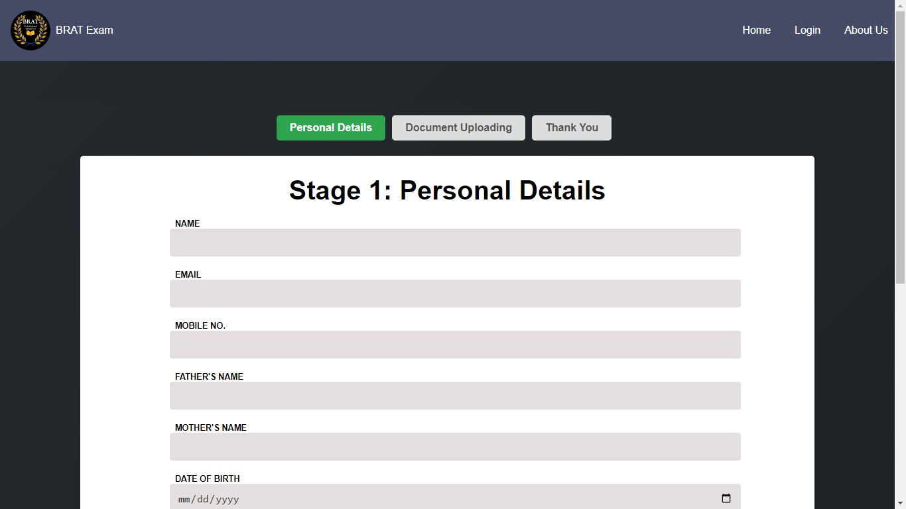
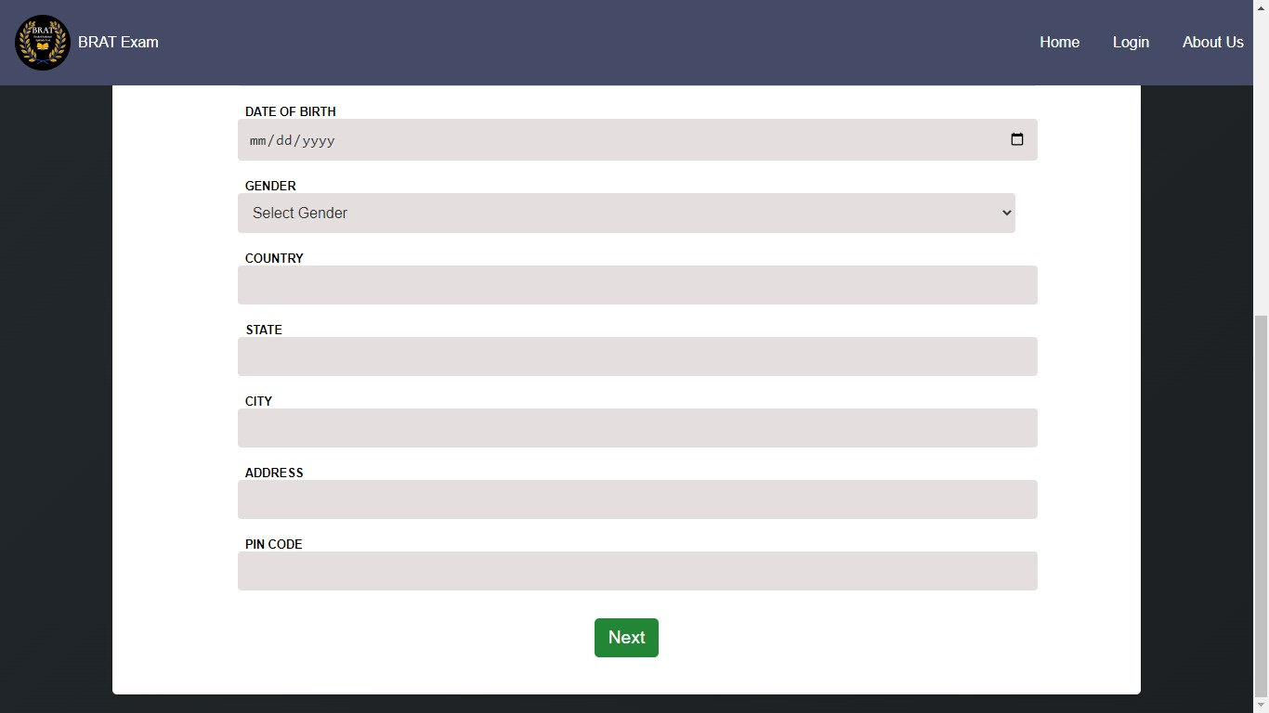
Result

Slide 13
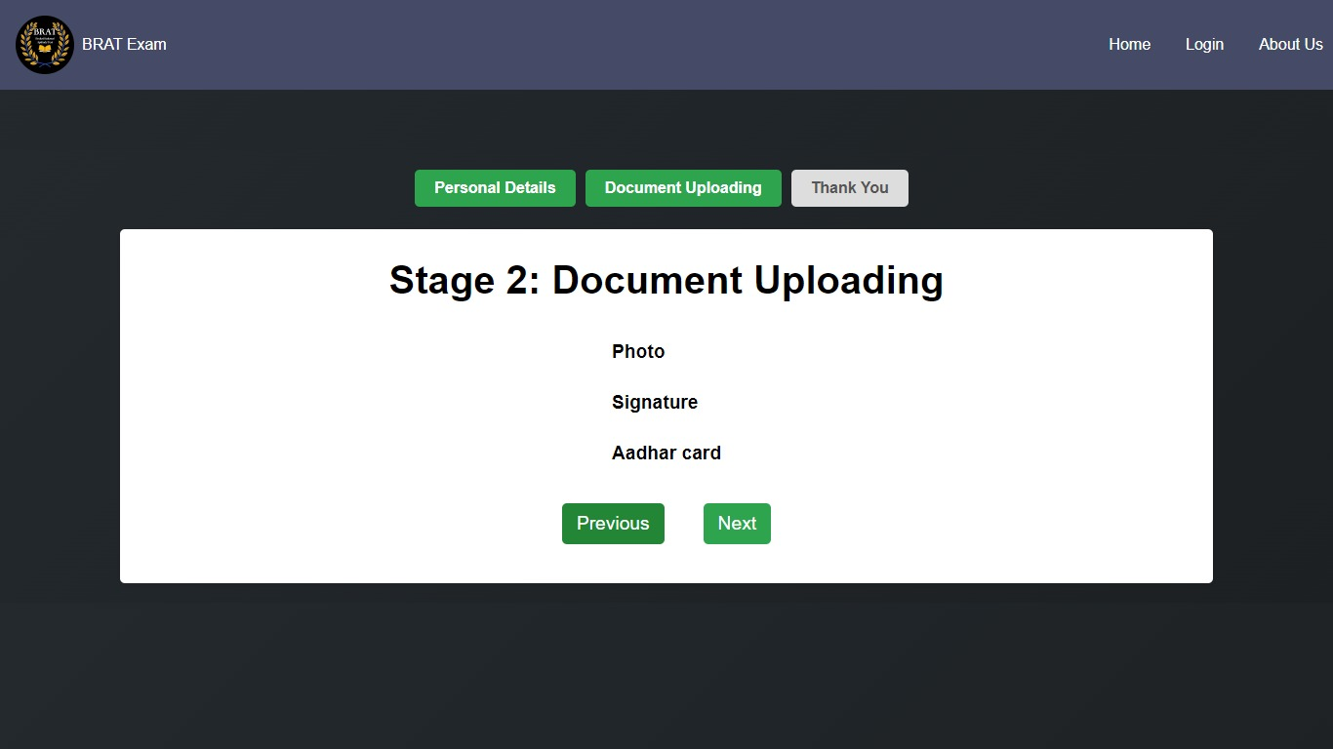
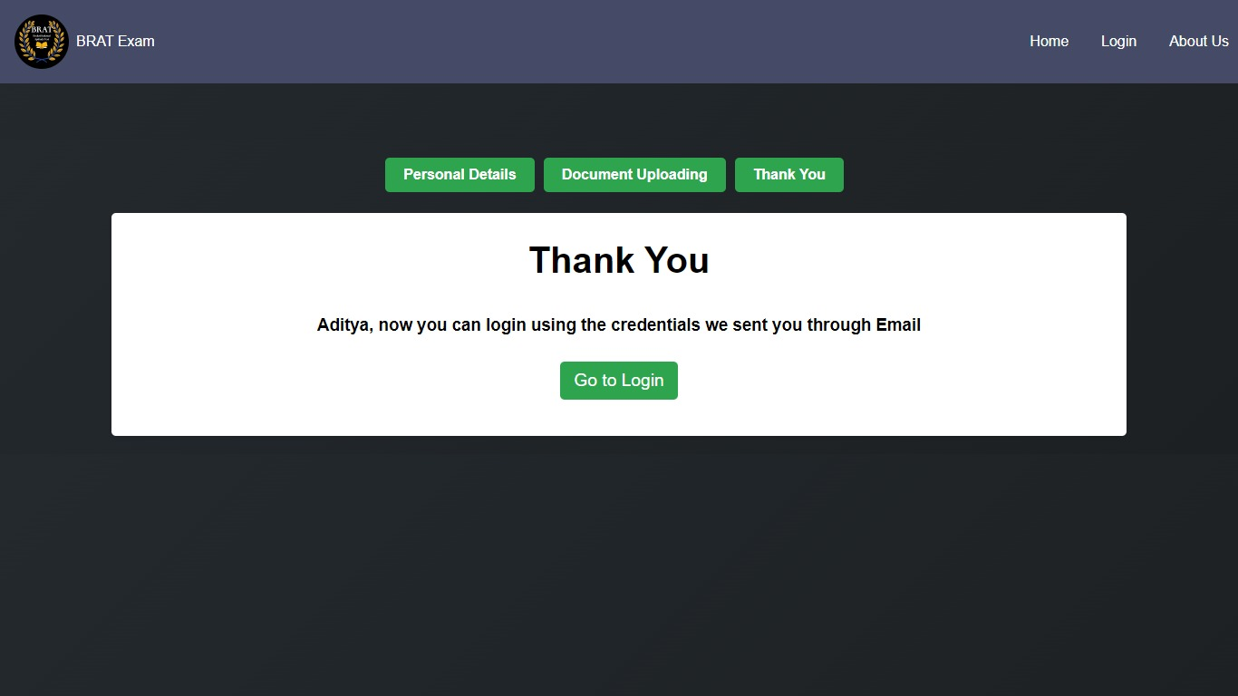
Result

Slide 14

Thank you

